Slide 1
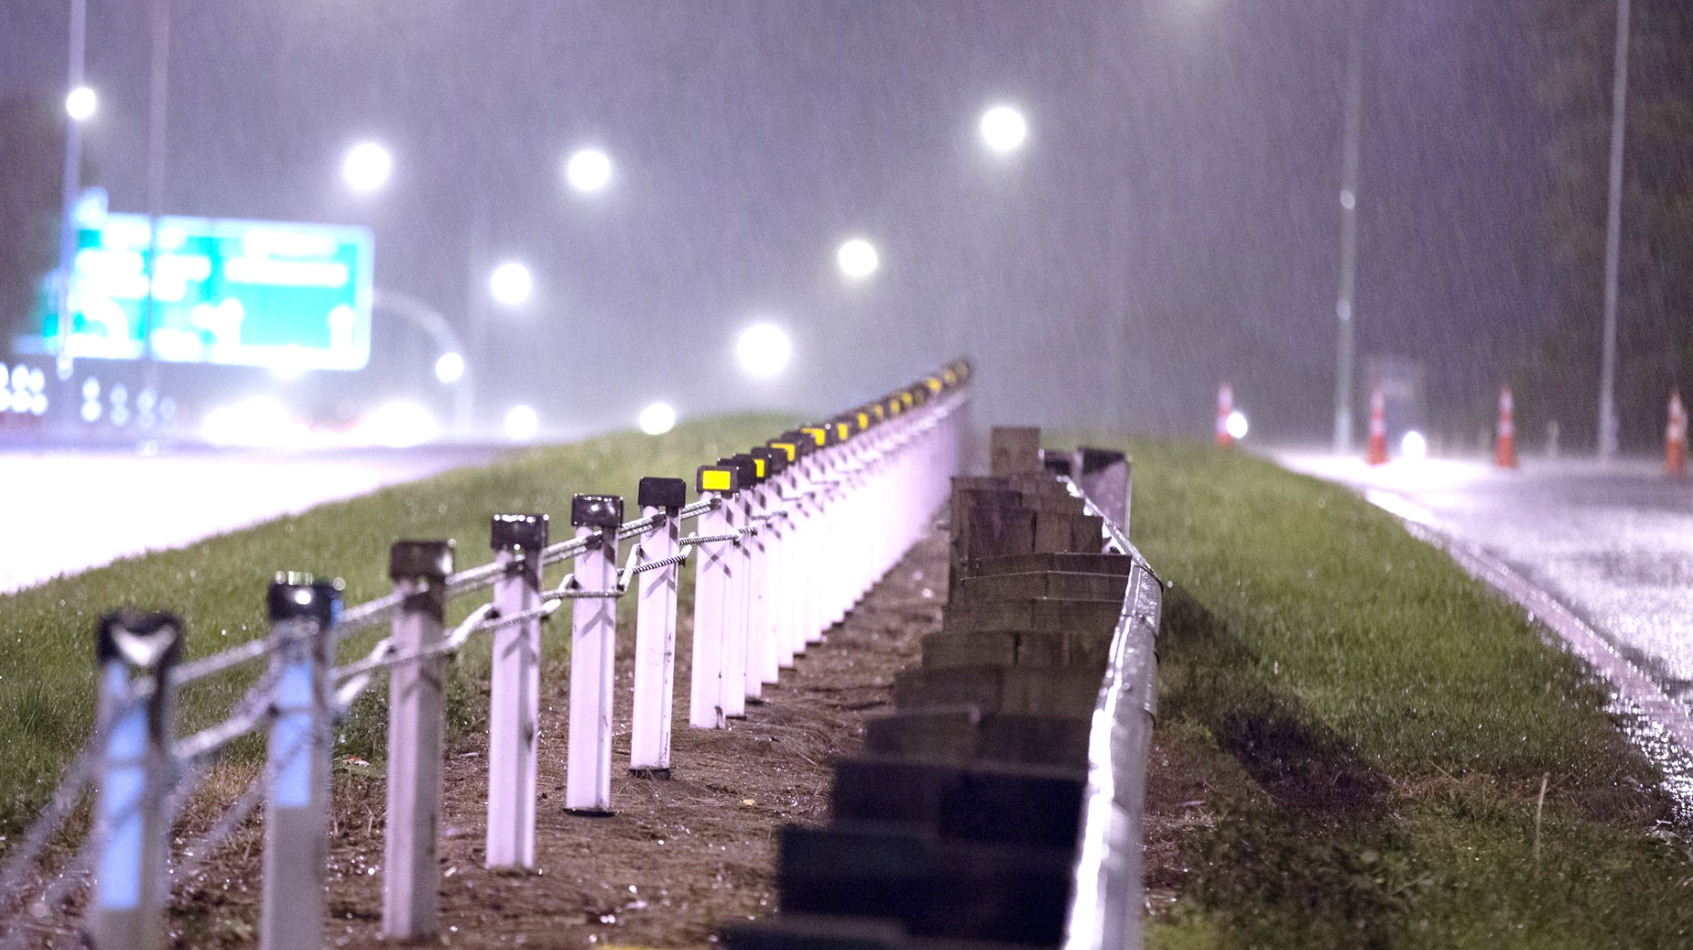
RAISING THE BAR
The case for Electronic Training – Technology’s place in the classroom
Electronic Training – Strengths, obstacles and our experiences
Taking Electronic Training Online – The case for ONLINE training
Online Training – Strengths, obstacles and our experiences
Questions – What do you think?
Notes:
Smartphone test: “delivering new zealand a thriving transport network” (MARIUS)
Why are we here and what do we do? What did we set out to do? (MARIUS)
NZTA the trigger with Train the Trainer workshops
programme (DAVE)

Slide 2
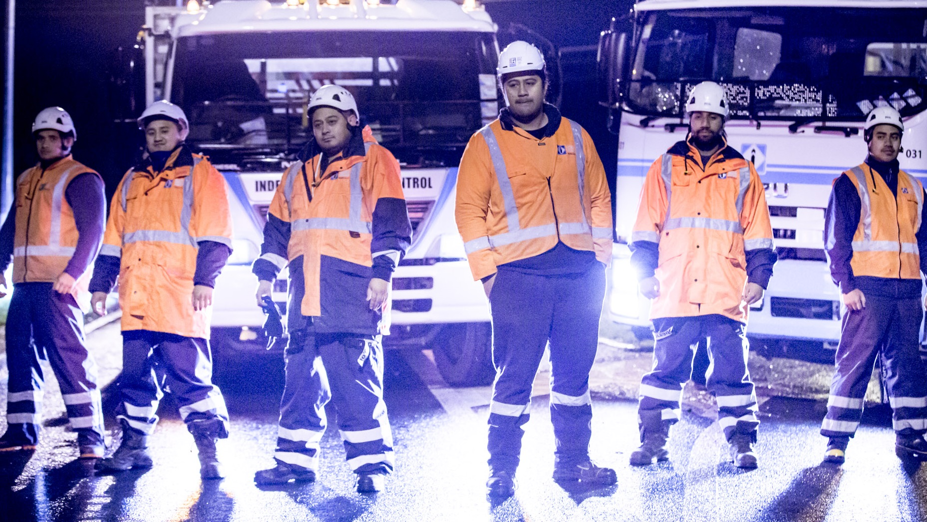
The world is changing – learning has already evolved. 47 of the NZX 50 companies use e-learning
ELECTRONIC LEARNING
Industries and companies are evolving quickly
In 2013 the number of smartphones in the world exceeded the number of humans
The average household has 5 internet connected devices
Notes:
DAVE
This is not a secret. And I don’t need to seel you why electronics are becoming part of daily life.
My for learning though? Why does training use it?
Two questions:
Why any training, and
Why for our industry?

Slide 3
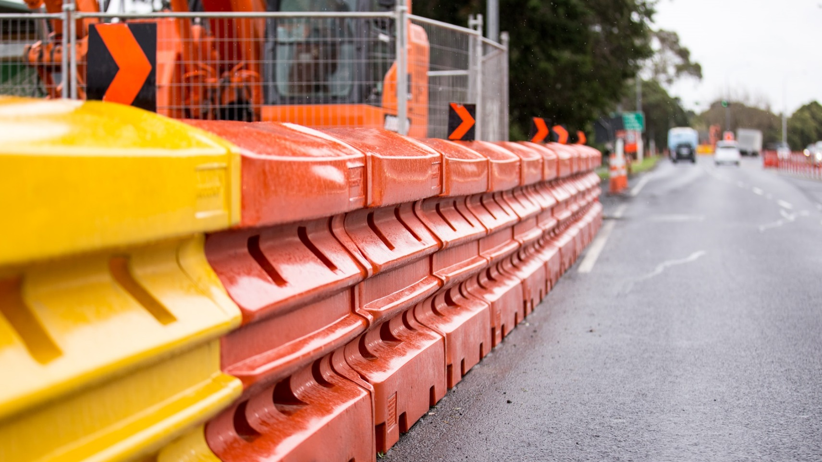
Personalized learning – each person has their own window into the material
Flexibility and adaptability and extension of information
Speed (of navigation and analysis of information)
Testing methods – immersion in the information for testing
Multimedia
Data analysis (of results)
STRENGTHS
Notes:
DAVE
Strengths of electronic methods

Slide 4
Technologically challenged
OBSTACLES
Reliability
The material has to fit the method
Loss of collaboration
Notes:
OBSTACLES (MARIUS)
Technologically challenged? – How do we deal with the different skills levels in the room
What about technological reliability? No power no course material – Battery life etc
We have to improve the material. We have to USE the full depth of capability of electronics to make it worth it. (multimedia, animations, interactions, IMMERSION into the information)
People look down – instead of up. The risk of detaching from society

Slide 5
August 2014 we began paperless training
We have trained over 750 people electronically – TC, TC-I, , STMS, WCTL and refreshers
WHAT WE’VE BEEN DOING
Notes:
WHAT WE’VE BEEN DOING (MARIUS)
Well the past year have given us incredible insight to some of the challenges
Time and resources invested into the development was huge

Slide 6
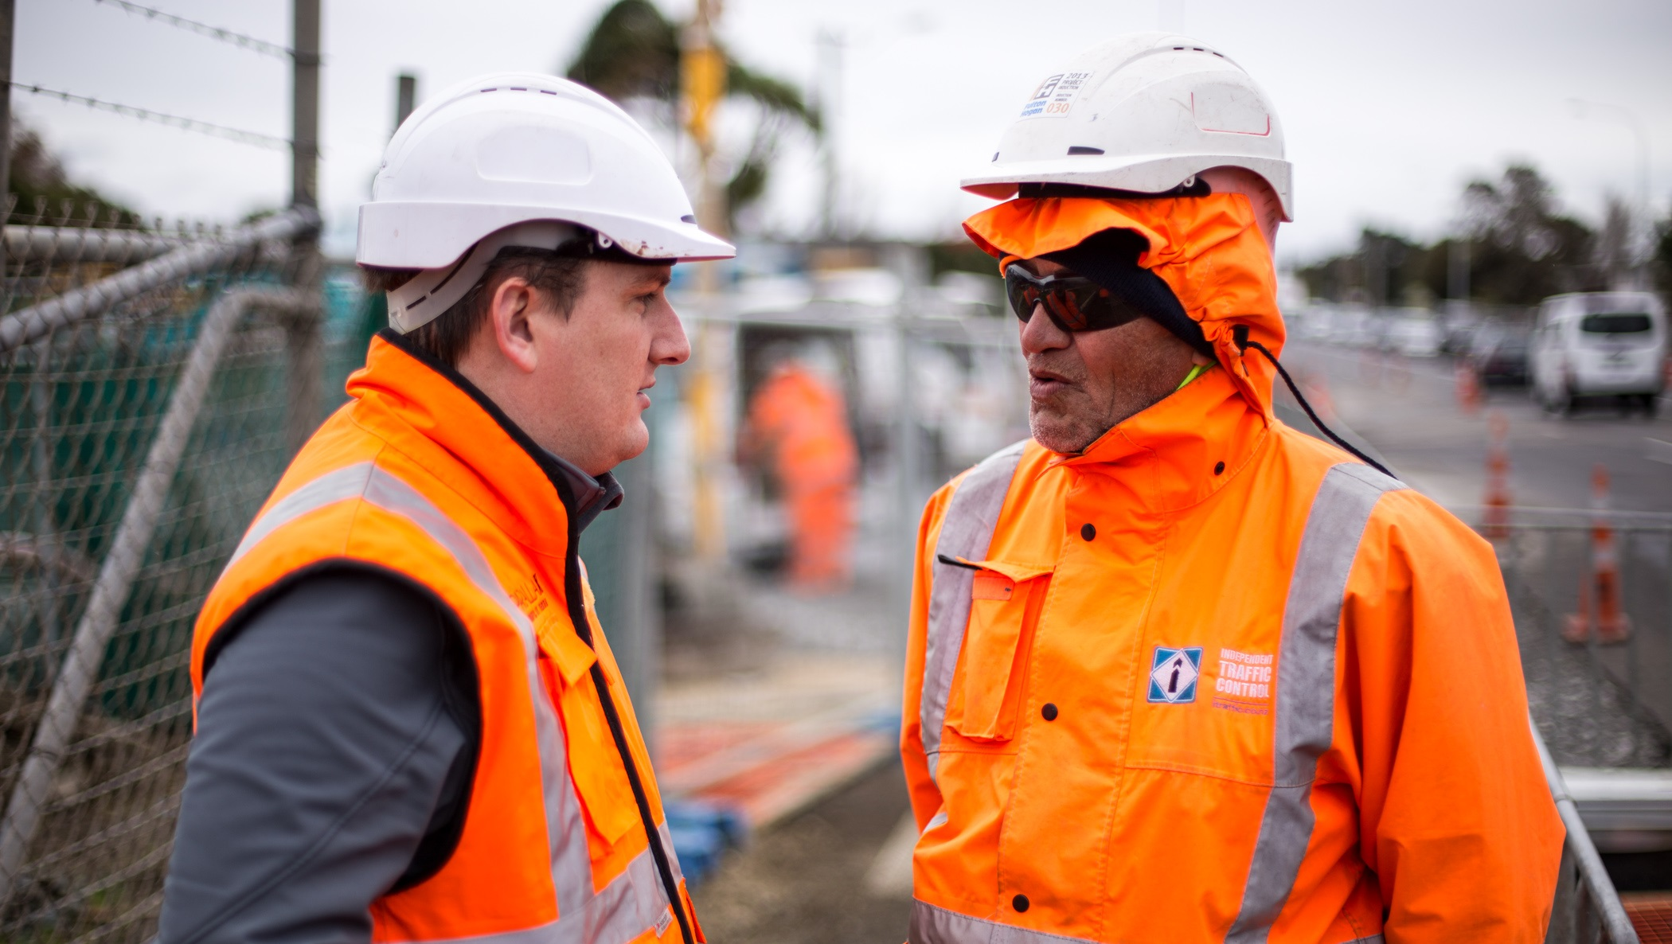
Flexibility
ONLINE
Self-directed
Geographically unconstrained – better nationwide consistency
Notes:
THE CASE FOR ONLINE TRAINING (DAVE)

Slide 7
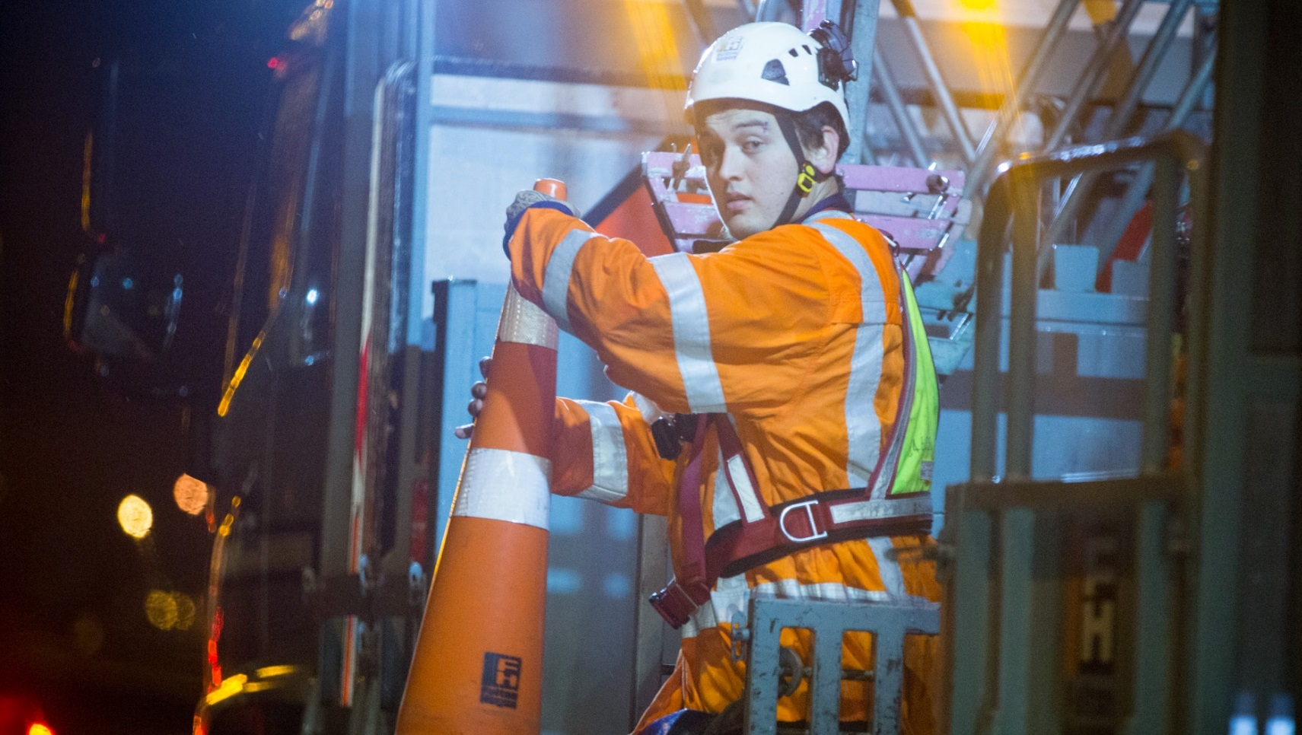
Loss of the ‘human’ element
Verification of identity
Maintenance of quality and value
Responsiveness – maintain the student-trainer connection
OBSTACLES
Notes:
(MARIUS)
Again loosing the human interaction because of the distant learning module
Verification multiple methods
Trainers phone call
Discussions and evaluation of partly completed courses
NZTA current or lapsed ID numbers etc.
Maintenance – the upkeep of the latest material at all times
Responsiveness – Constant contact with applicants on the progress of the course
Phone calls
Messaging system on the system
Emailing etc

Slide 8
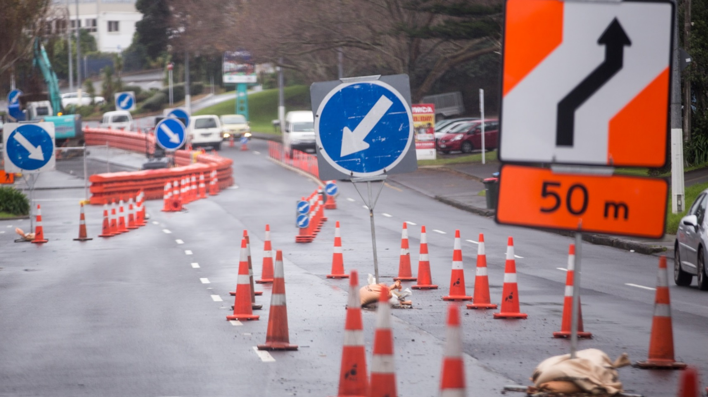
Trial 50 participants – June/July 2015
ONLINE TC REFRESHER
Course refinement – August 2015
Possible public launch – August/September 2015
Notes:
MARIUS

Slide 9
QUESTIONS
Notes:
MARIUS/DAVE

