Slide 1
Working Smarter in Increasingly Complex Environments
Presented by Darren Wu
Notes:
Afternoon Ladies and Gents, my name is Darren Wu and I am a traffic engineer working at Beca based in Auckland. I have been working for almost nine years now work since uni I’ve been quite heavily involved in traffic management during this time. Whilst my experience fails to compare against many of you in the room I’d like to think that I am genuinely in a position to be able to reflect on this industry and share an opinion or 2 about where it needs to head. So, when I saw the theme for this year’s conference of ‘Raising the bar,’ I thought it was fitting to acknowledge and talk about the changing environments in which we conduct Traffic Management and how we can work smarter.

Slide 2
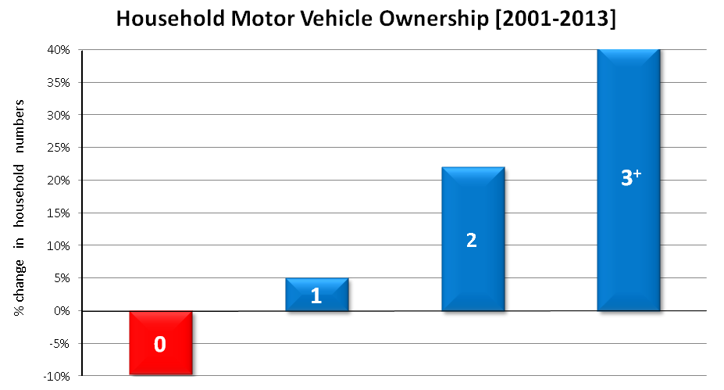
The data tells us…
Notes:
I would like to start this presentation by building a picture of the increased complexity in our work environments. From our national census data, I first took a look at the change in motor vehicle ownership per household between 2001 and 2013. And what was surprising with the results was not only were the number of vehicles in NZ generally increasing but households on average are owning more cars than ever before.

Slide 3
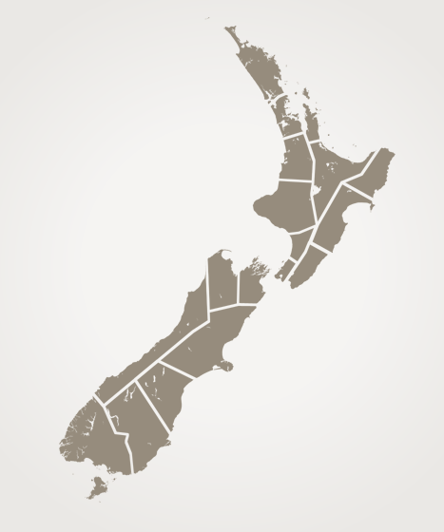
The data tells us…
⁺ 22%
⁺ 6%
⁺ 12%
⁺ 12%
⁺ 7%
⁺ 12%
⁺ 14%
⁺ 12%
⁺ 6%
⁺ 12%
⁺ 4%
⁺ 15%
POPULATION (2001 – 2013)
VEHICLE VOLUMES (2010–2014)
Notes:
With respect population numbers, many of the key centres around NZ are observing healthy increases and the same goes with vehicle volumes or trips on roads. What this all means is that we are dealing with busier roads and with more people across the board. And you don’t need to be a statistician draw the conclusion that the trend will continue to go upwards.

Slide 4
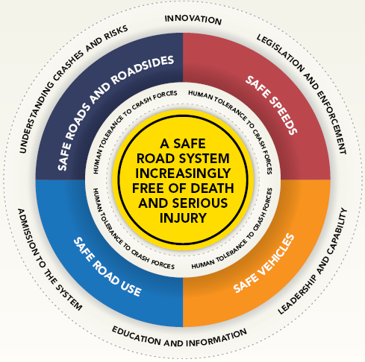
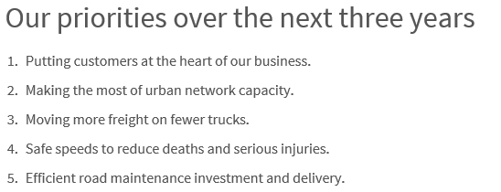
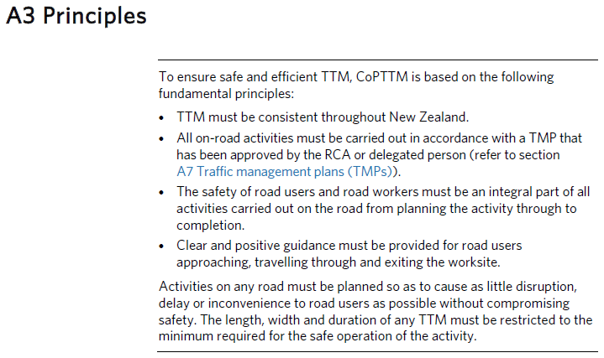
Our industry tells us…
Safety of the travelling public
Safety of the workers
Efficient utilization of the transport corridor for the work and the travelling public
Notes:
With the changing conditions, our approach and focuses have also had to adjust and this has been evident across the board.
The Transport Agency quotes putting customers at the heart of their business and supporting safer journeys.
Safer Journeys being an actual nationwide campaign promotes things like innovation and education and information to achieve safer outcomes in design and operation.
In Wellington, I was interested to spot 3 key objectives they had listed. With safety well presented, my attention was towards the effective utilisation of the transport corridor.
And how could we forget about CoPTTM which does focus a lot more on how TM is implemented but nonetheless highlights the need for consistency, safety and clarity.
If we just pause and collate all of this together, you start to actually see an acknowledgement of the increasingly challenging environments across the regulatories and authorities.

Slide 5
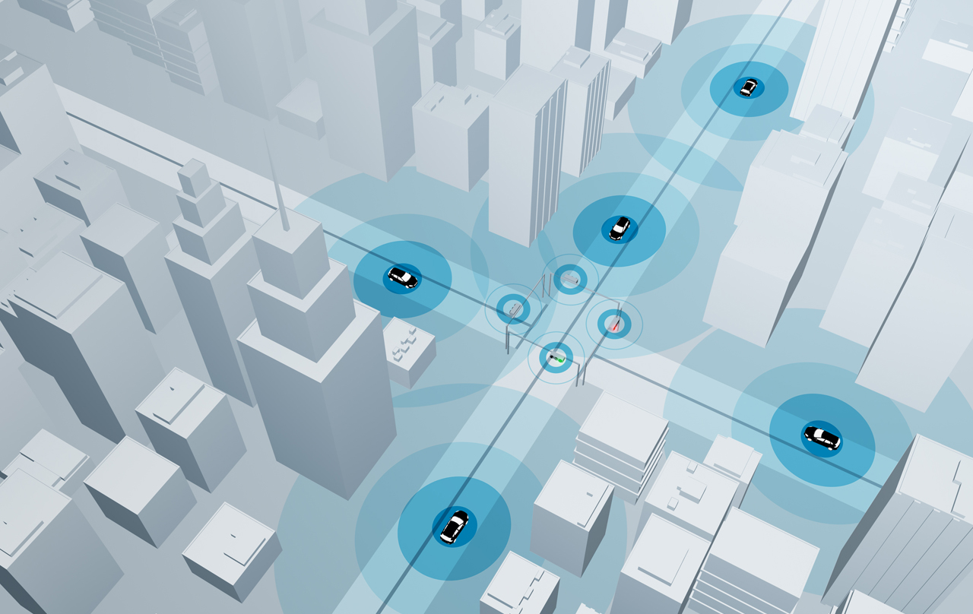
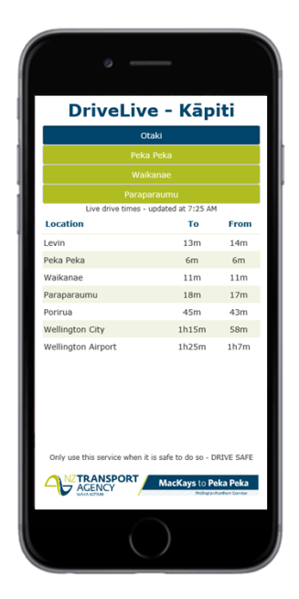
The future indicates that…
Notes:
As I conclude this picture of increasingly complex environments, it is only fitting that we look ahead. The world is changing rapidly and our industry is not excused from it. What will it bring and how will it affect what we do? As technology, society and infrastructure changes we will need to also.
The picture on the side shows something Beca has actively been involved in by using bluetooth bliptrackers to monitor realtime journey information. Easy to use apps then provides this information directly to the palm of motorists hands. And this is only one small example of what is out there.

Slide 6
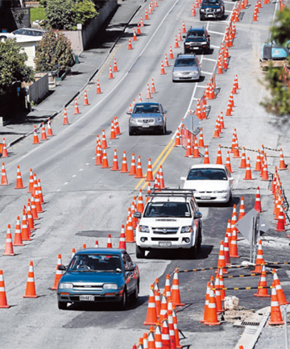
The bar has been raised
Construction Requirements
Consistency
Safety of road users and workers
Community engagement
Effective use of the network
TMP Design (CoPTTM)
TMP Implementation
Notes:
So if I were to simplify it, this would be how most of our industry operates… Based on the construction requirements, TMPs will be developed and then implemented to allow for the work to happen. Whilst we are in most cases achieving compliance there are a few curly ones every now and then like this one which sparked a bit of a humorous swipe from a local paper about the number of cones used.
More importantly though, whilst the step process above achieves compliance the increasingly complex environment has raisied the bar and challenges us all in terms of what we should be aiming for. I believe the bulls-eye has changed which means many of us are only hitting the periphery of what could be achieved.

Slide 7
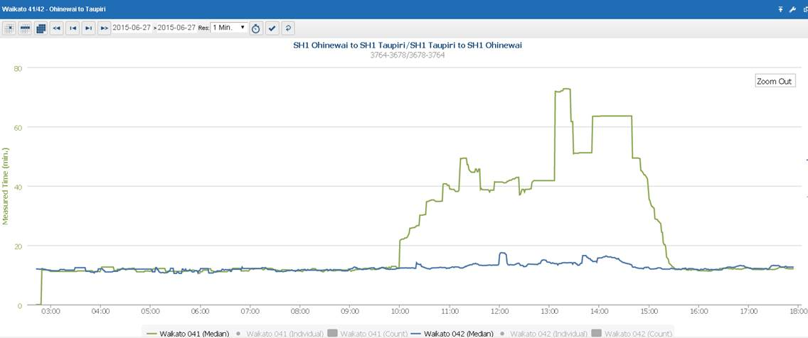
Hot off the press!
Notes:
SH1 SB Ohinewai to Taupiri
Average journey – 17mins ish
Delayed journey time up to 70mins (+50mins)
10am build up stop at 3pm.

Slide 8
The Smarter Way Challenge
TM OBJECTIVES
Consistency
Safety of workers
Safety of road users
Customer focus
Effective use of network
Innovation
Education and Information …
Construction Requirements
1. Traffic Management
2. Construction Methodology
e.g. TIA,
TM Strategy, TMP Proforma
3. Communication / Stakeholders
4. Contingencies
TMP Design (CoPTTM)
5. Monitoring Plan
TMP Implementation
Notes:
Old process needs to be made scondary;
TM Objectives made as #1
Close the road from construction requirements directly connecting with TMP and take the smarter way detour
Then we are realigning to target this bulls-eye better
Examples of the detour include TIA, TM Strategy and Proforma

Slide 9
The Smarter Way Detour
3. Communication / Stakeholders: The components required to develop key messages and how they can be most effectively delivered to the target groups to achieve highest compliance with requested behaviours
Who are the people affected and how are they affected?
What messages need to be communicated to who?
How can the messaging be communicated effectively?
TIAs / TM Strategies / TMP Proformas
1. Traffic Management : The components which make up the understanding of the network operations such that the traffic management implemented will ensure acceptable conditions are provided to road users.
What road space do we need and what can we take?
What are the likely impacts? Does this adjust our plans?
Can I use the wider network to manage impacts?
Are there innovative ways to manage traffic conditions?
4. Contingencies: A series of backup plans to manage the network conditions should operations become unstable.
What are the risks areas for the operations?
What back up plans are required to address them?
Who calls the shots?
2. Construction Methodology: The construction activity that will ensure that the work has the highest chance of being completed on time or earlier.
Do they really need what they have asked for?
Re-working the methodology if there are limitations to TM.
Can additional work be carried out in the same closure?
If we could take more space and time, could more be achieved that would save on future closures?
5. Monitoring Plan: A plan for monitoring operations during peak times to assess for improvements or activation of contingency plans.
Where are the key areas to watch?
When do they need to be monitored?
Who is responsible for what?
Where does the information go?
Notes:
I want to touch on this briefly as I come to a close soon but I just wanted to expand on the Smarter Way Detour a little. Because of the increasingly challenging environments that we work in, some RCAs are having to align with this.
The terms Traffic Impact Assessments and TM Strategies are increasingly used but there is often confusion or varying definitions about what they are.
Well – I think it pretty much is a smarter way detour which starts to consider all the various elements of how we can work smarter in these complex environments. They can be big reports, they can be short letters, they can be a bulked up TMP Proforma or it could simply be a conversation. The importance of it is that by taking the smarter way detour, you ultimately add value to your Traffic Management.
The five areas listed above I believe cover our considerations holistically.
Run through example questions.

Slide 10
When TM is done well
Safety & Wellbeing
Safer work areas for site crew
Safer journeys for motorists and active mode travellers
Programme Efficiencies
Maximise construction activity in work area
Challenge status quo arrangements
Benefits
Traffic management activity
Construction activity
Road user costs (travel time, petrol)
Cost
Risk Management
Network impacts
Reputation of project and involved parties
Positive Stakeholder Management
Acknowledgement of affected community
Timely communication
Supportive stakeholders
Notes:
Programme Efficiencies
Positive Stakeholder Management
Safety and Wellbeing
Cost
Risk Management

Slide 11
Discussion Panel
Andrea Williamson – Network and Systems Manager (MHXK)
Fletchers
Duncan Edgar – Network Traffic Management Coordinator
Auckland Motorway Alliance
Laurence Jones – Team Leader Works Approval (Cntrl & Sth)
Auckland Transport
Notes:
Q1(to AT) – Having been in the industry for a while what have you noticed over the years about the change in environment in which we work in?
Suggested components for answer: Stakeholders are more vocal than ever, this drives greater risk if TM is not well planned or communicated. We are working in busier conditions meaning there are greater sensitivities by any disruption due to TM.
Q2 (to AMA) – As someone who has a more holistic view of traffic management activities across a road network, what do you see as the key areas of improvement for our industry?
Suggested components for answer: Time for preparation needs to start earlier, there needs to be more consideration of the holistic impacts (impacts and use of neighbouring networks, times of the day, stakeholder consideration, network operational performance), there needs to be more collaboration (working with Operation Centres, adjacent projects etc..),
Q3 (to Fletchers) – Do you see The Smarter Way Challenge as something that would add value to what you do? And how do you think it could be applied?
Suggested components for answer: Acknowledge some of the challenges of time pressure which often pushes the industry to do TM in the basic process. The Smarter Way may not be easy to adopt but it is clear in terms of the value that it can add and the industry needs to continue to progressively aim towards hitting the raised bar.

