Slide 1
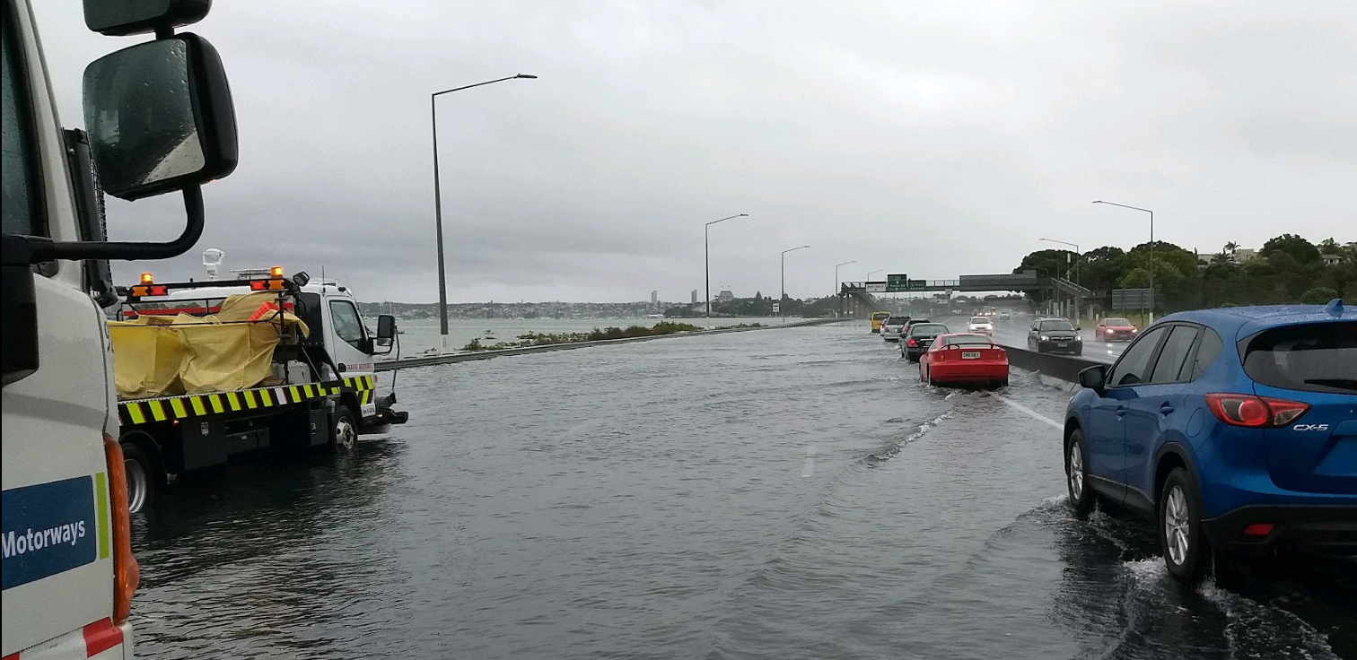
Operating a network; enhancing incident response
We help New Zealand grow by keeping Auckland moving.

Slide 2








Seven organisations form the Auckland Motorway Alliance

Slide 3

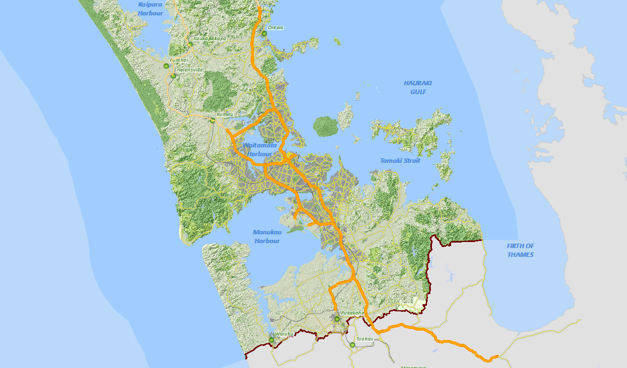
Network extent
From Puhoi to Pokeno
Titfords Bridge
SH1
SH18
Brigham Creek Road RAB
Quay Street / Tamaki Drive
SH16
Maioro Street
SH20
SH20A
~Verissimo Drive RAB
SH20B
Orrs Road
SH1
SH22
Adams Drive
SH2
Pokeno
SH25 RAB

Slide 4
Typical minor

Slide 5
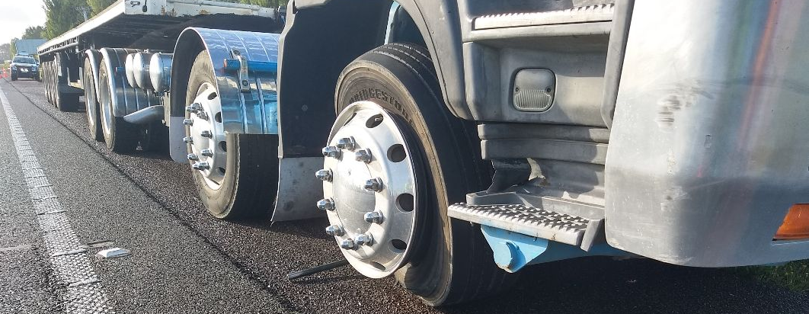
Vehicle failure

Slide 6
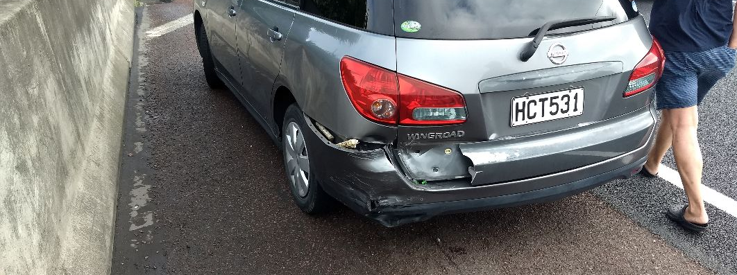
Minor crash

Slide 7
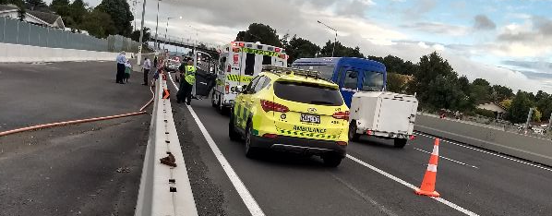
Medical event

Slide 8
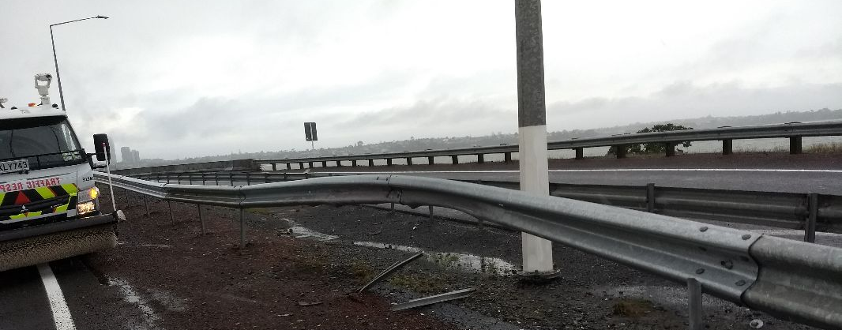
Minor asset damage

Slide 9
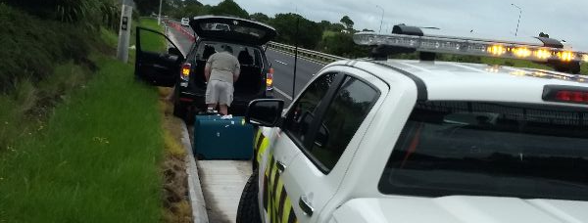
Unsecured load

Slide 10
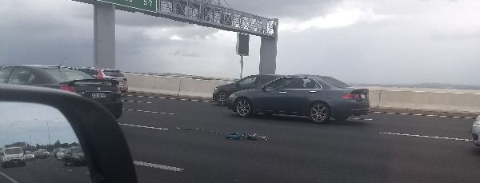
Unsecured load

Slide 11
Typical Serious Incidents

Slide 12
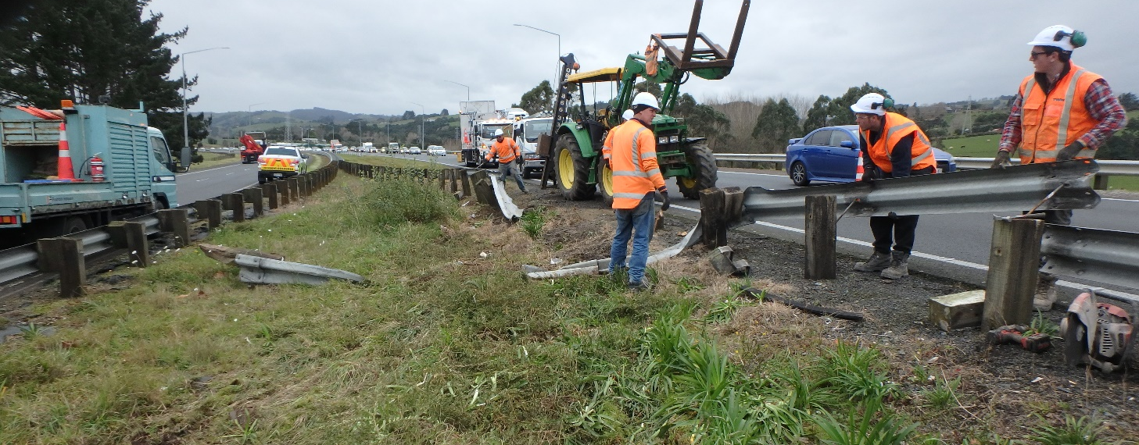
Asset damage

Slide 13
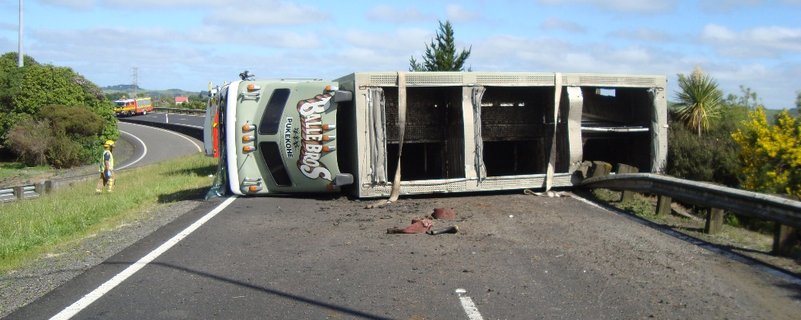
Truck Rollovers

Slide 14
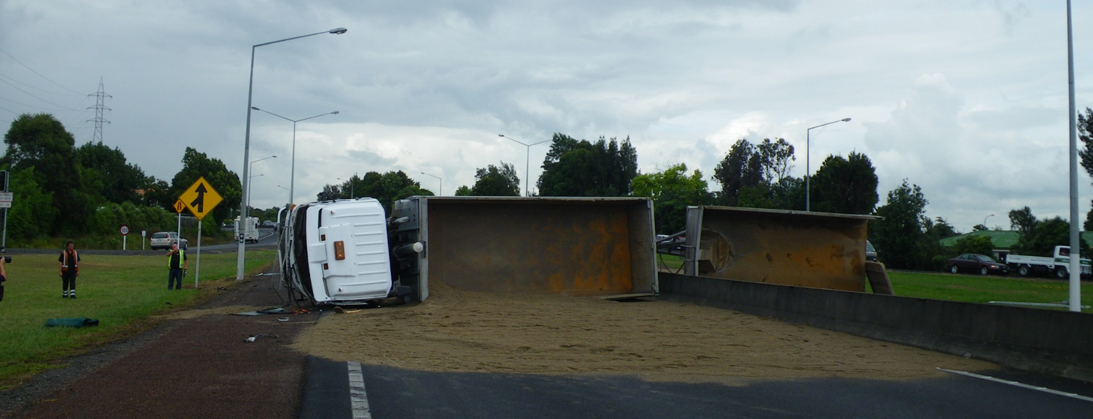
Truck Rollovers

Slide 15
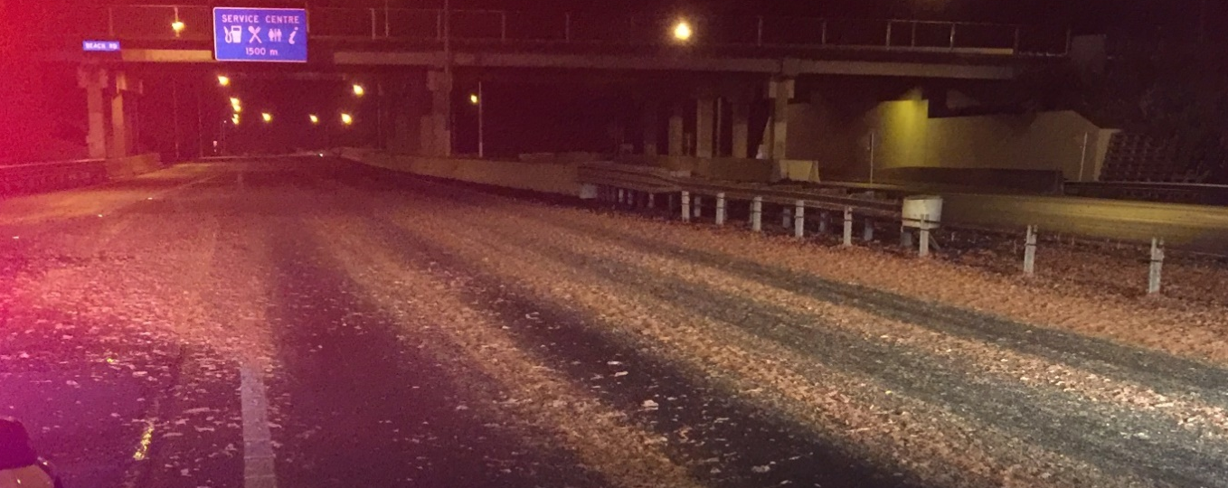
Spills

Slide 16
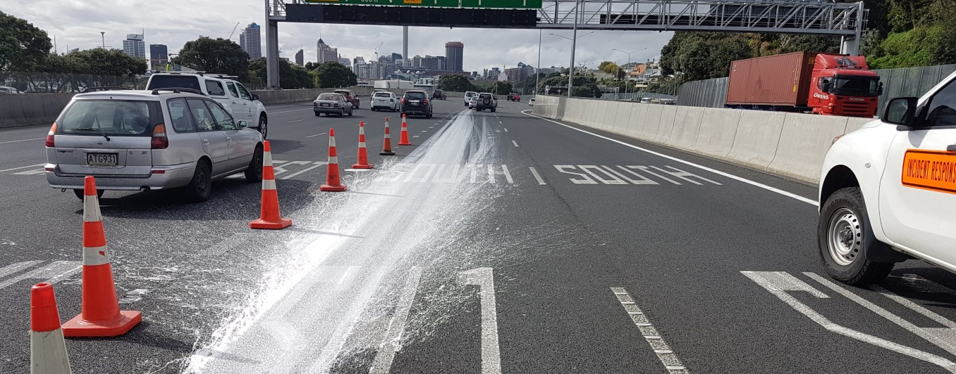
Spills

Slide 17
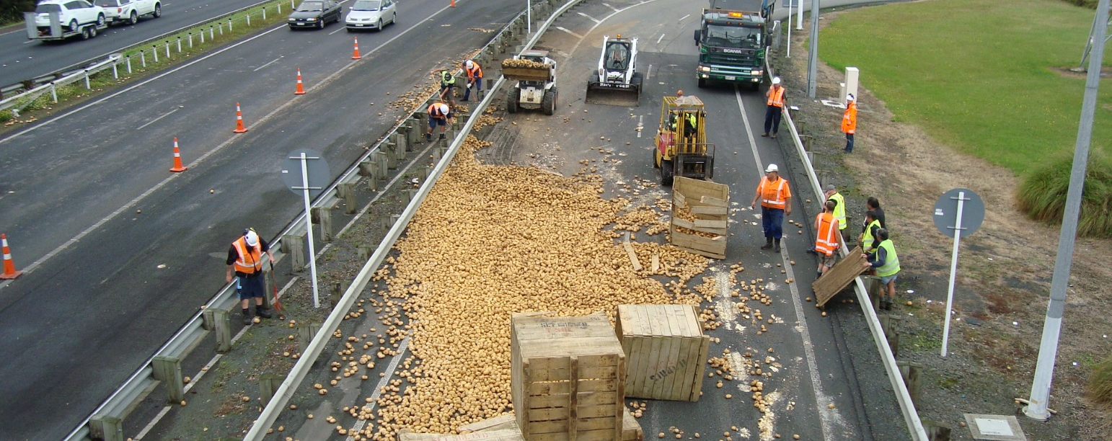
Spills

Slide 18
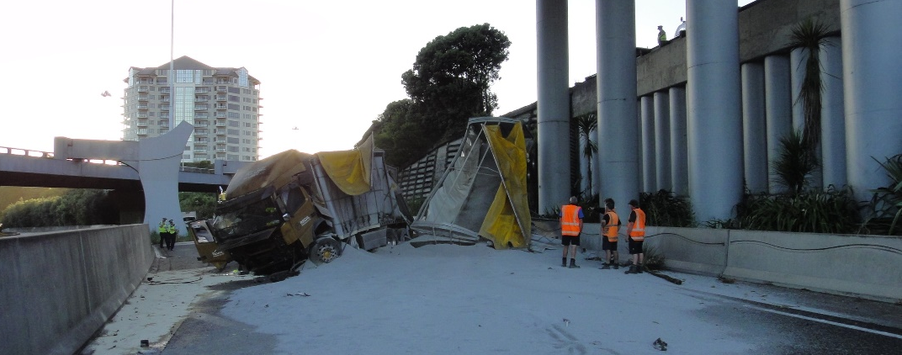
Spills

Slide 19
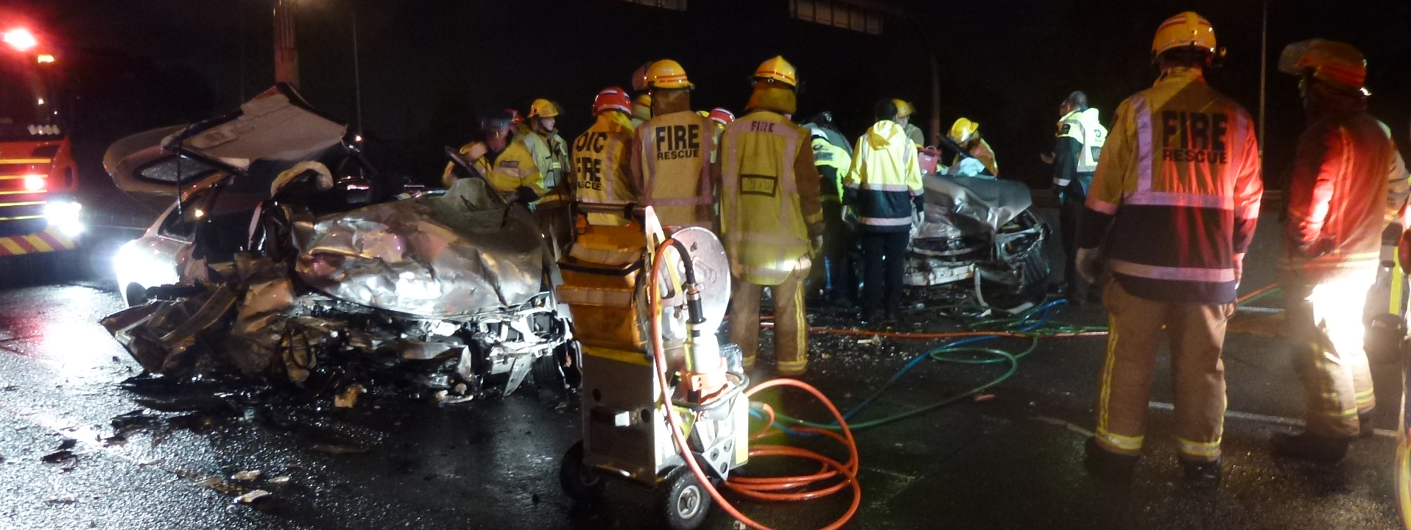
Serious crash

Slide 20
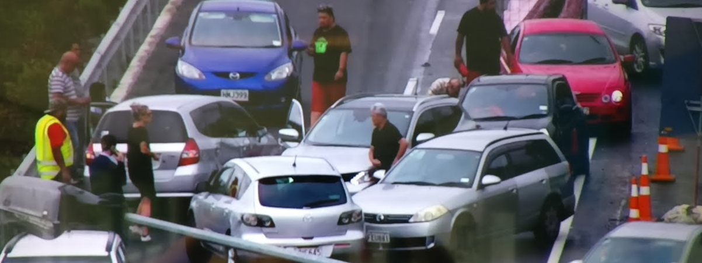
Multi Car Pile-up

Slide 21
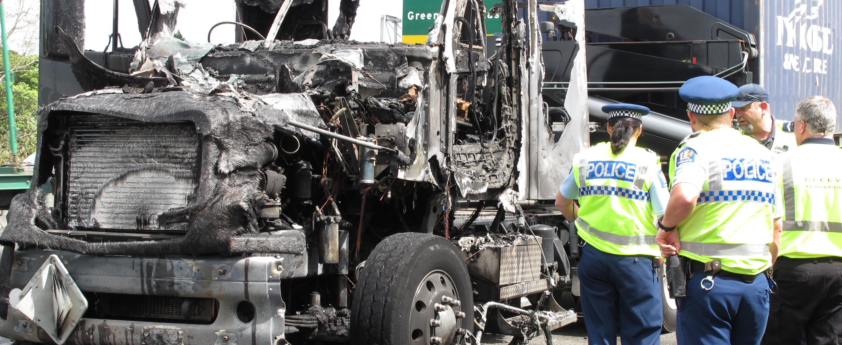
Vehicle fire

Slide 22
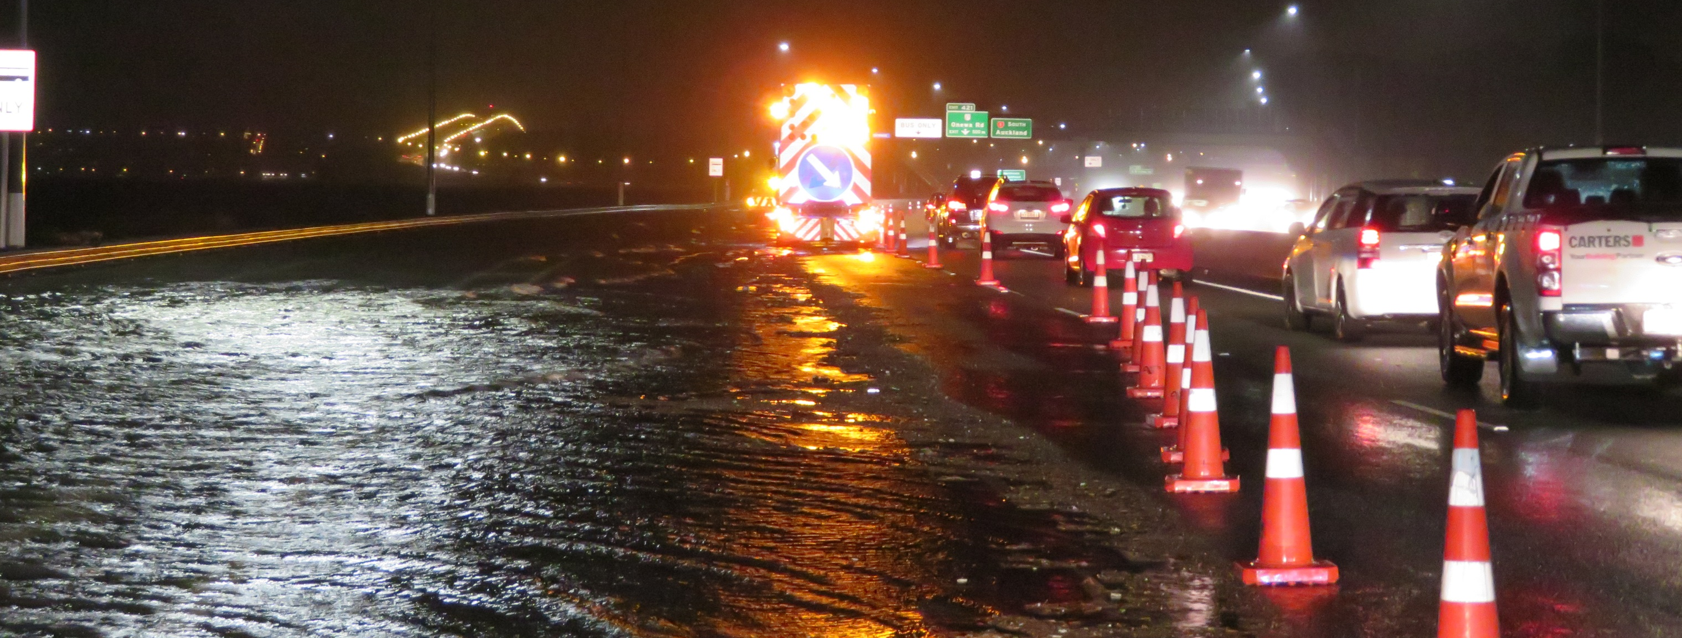
Tidal inundation

Slide 23
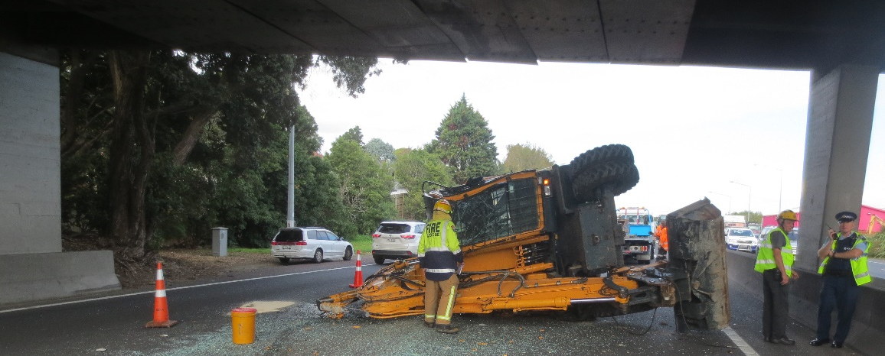
Bridge Strikes

Slide 24
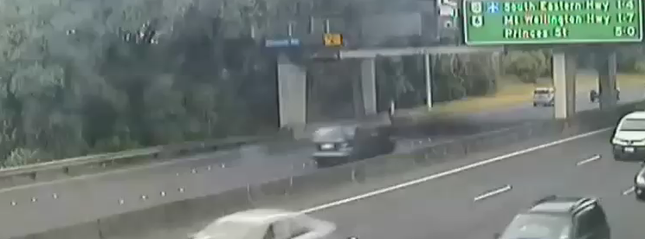
Bridge Strike

Slide 25
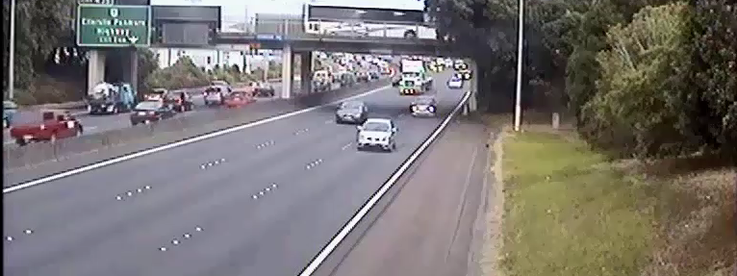

Slide 26
Challenges:
How we consider the traffic conditions (normal operation Vs congested).
CoPTTM mind-set (planned activities Vs unplanned incidents).
Emergency Services focused on inner cordon (life, environment, law).
Network operators have a responsibility to keep the road environment safe.
Reactively attending situation without warning
Decamping from site safely with cohesion amongst responders
Maintaining context of emergency traffic management

Slide 27
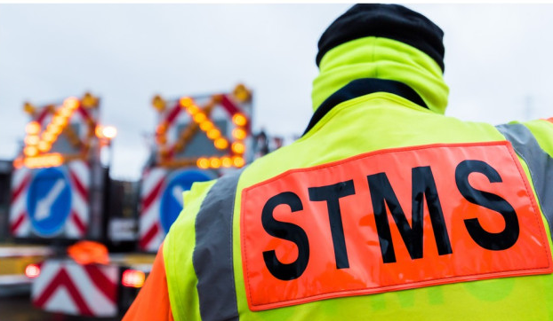
CoPTTM mind-set (planned activities Vs unplanned incidents).
“A7.8.1 Dealing with emergencies TTM used in unforeseen emergency situations is to comply with the practices in CoPTTM as far as practicable.”

Slide 28
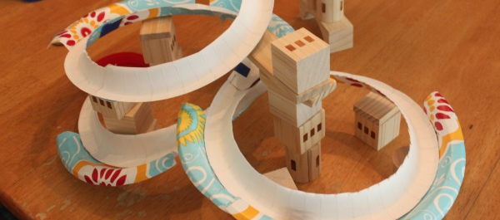

Slide 29
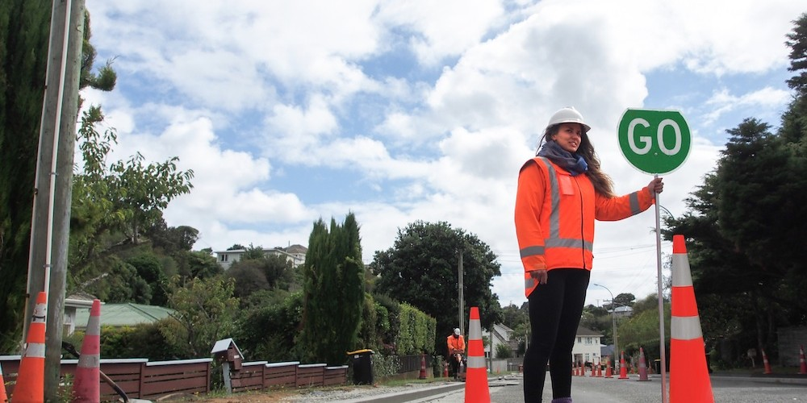

Slide 30
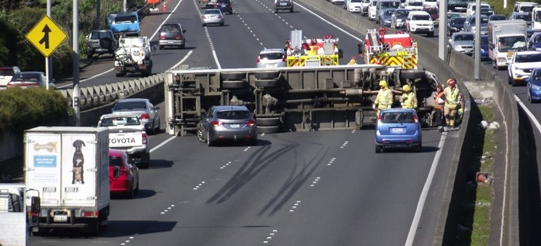

Slide 31
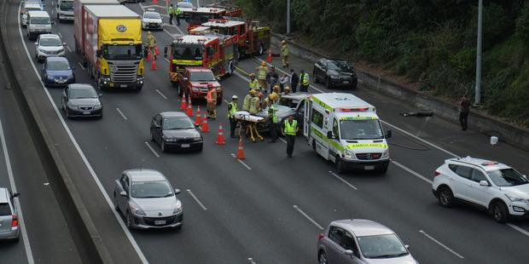

Slide 32
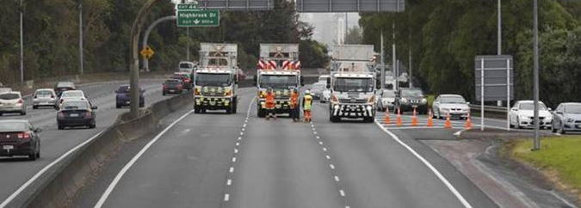
Use of resources

Slide 33
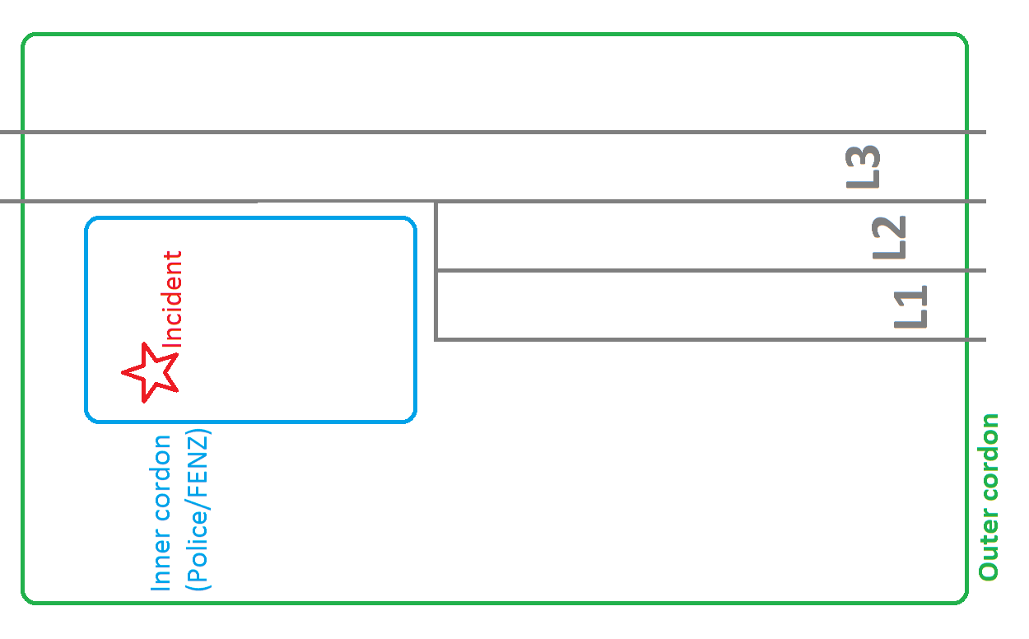
Use of resources

Slide 34
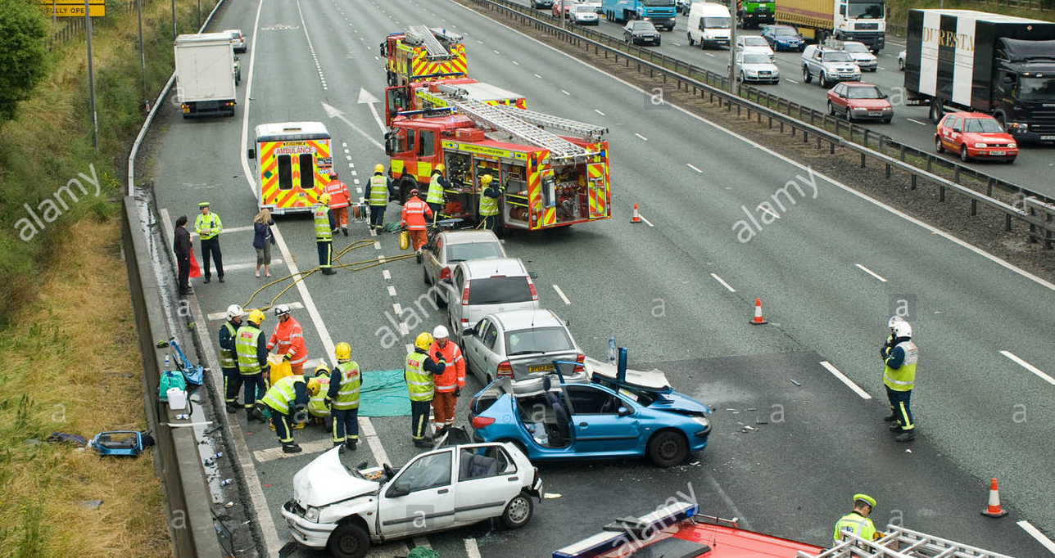
Emergency Services focused on inner cordon.

Slide 35
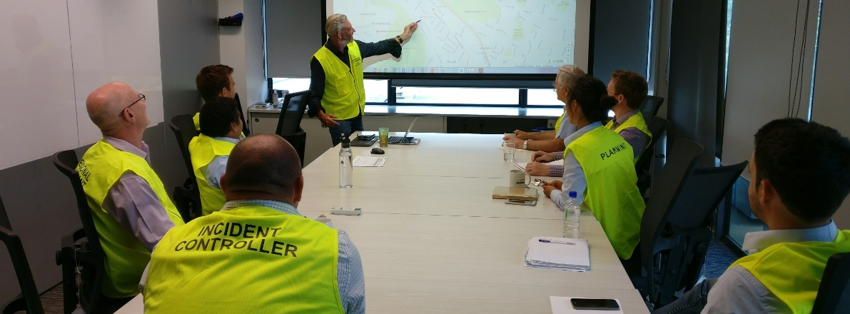
AMA Emergency Operations Centre (EOC)
Notes:
CIMS Roles - WHO??
Incident Controller – Hierarchy (Operational/Tactical/Strategic)
Planning & Intelligence – Asset Management Inspections
Operations – on the ground
Logistics - resources
Additional Support Services (No photos)
Communications Manager
Welfare Manager
Safety Manager
Other resources - Catering, Supplies, etc..

Slide 36
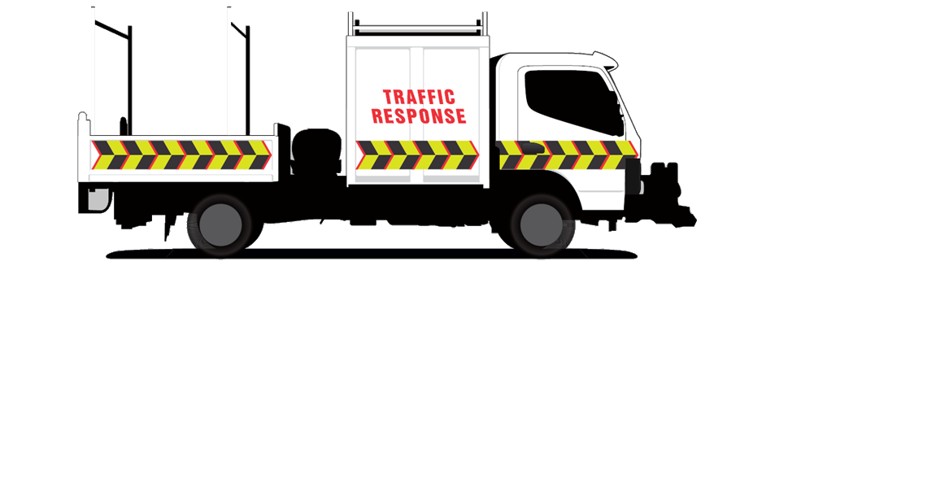
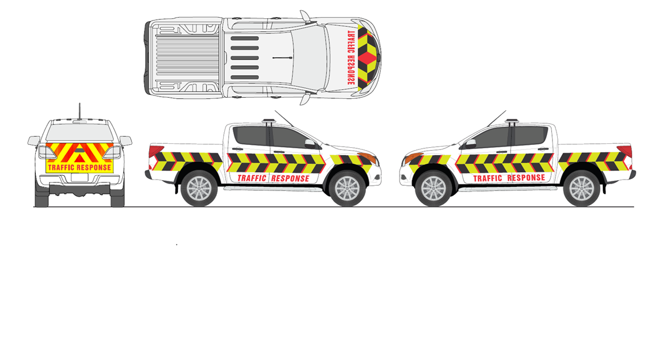
Maintaining context
Registration of vehicle livery to the Agency
Vehicle lighting fit out

Slide 37
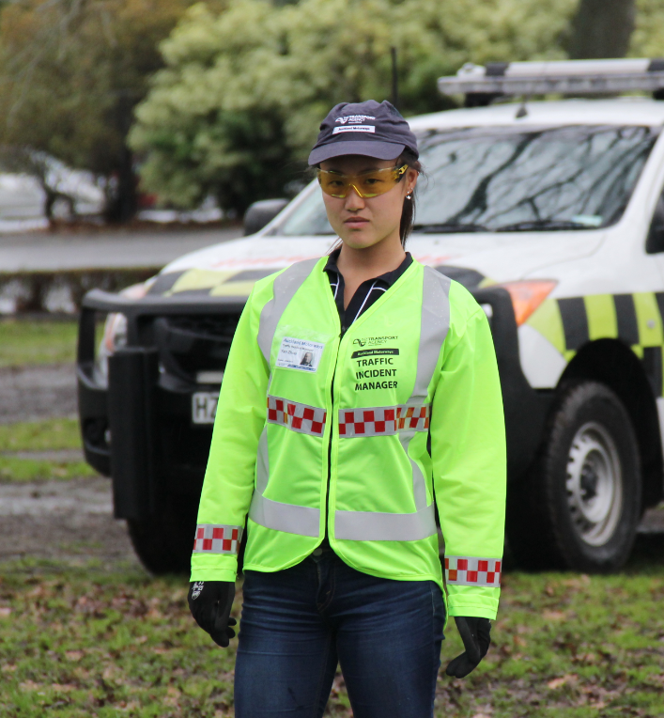
Traffic Incident Manager (TIM)
Performs the role of NZTA recovery Manager:
  Liaison with responders
  Command and control
  Intelligence (SitReps)
  Traffic management
  Identify and mobilise specialist plant ASAP
  Asset restoration

Slide 38
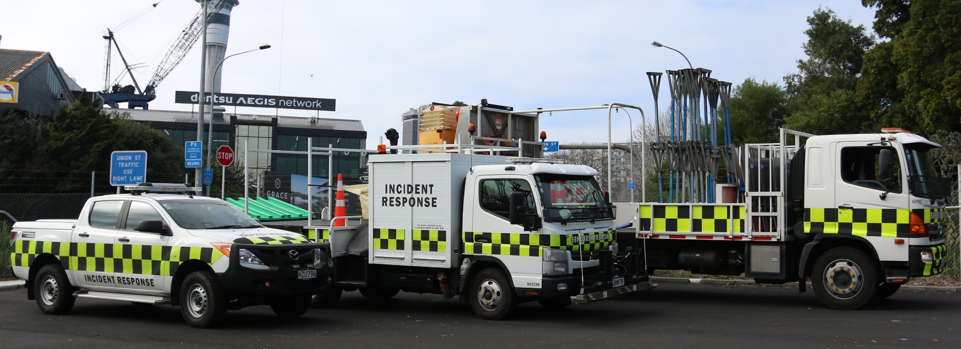
Incident Response Crews

Slide 39
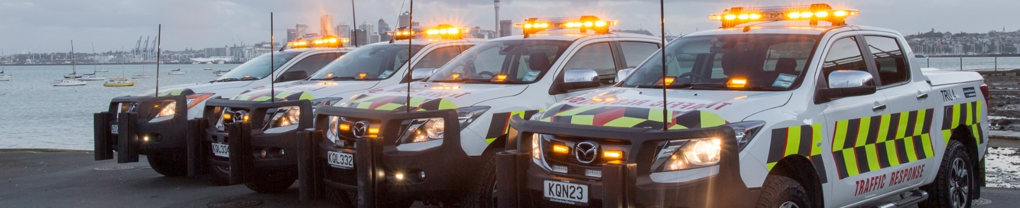
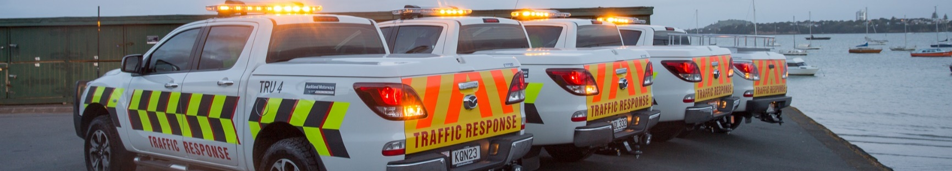
Do more: Traffic Response Unit

Slide 40
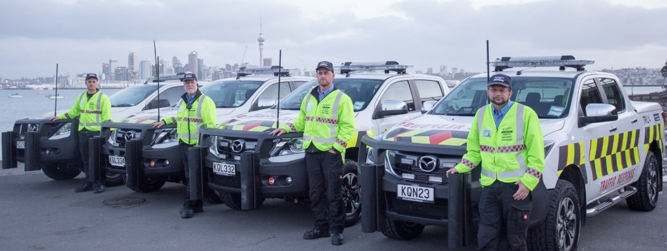
Do more: Traffic Response Unit

Slide 41
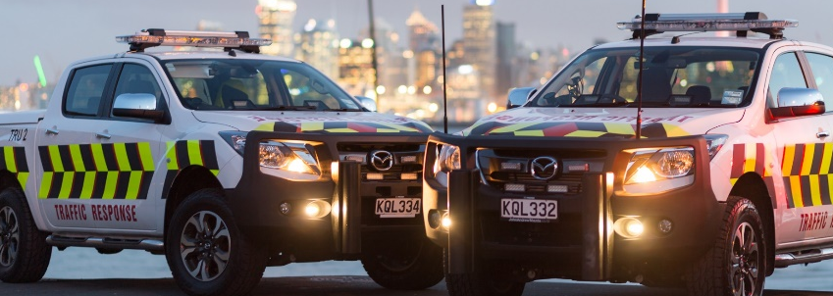
Clearing Blocked Lanes
Push Bars – Nudge Bars

Slide 42
Command arrangements
Duty Engineer
Crash investigation and control as required
TIM
Site Control and Reporting to ATOC
Leading Hand/Supervisor
Control of Crew
STMS
TTM and outer cordon
External Specialised Resource
Resource operation

Slide 43
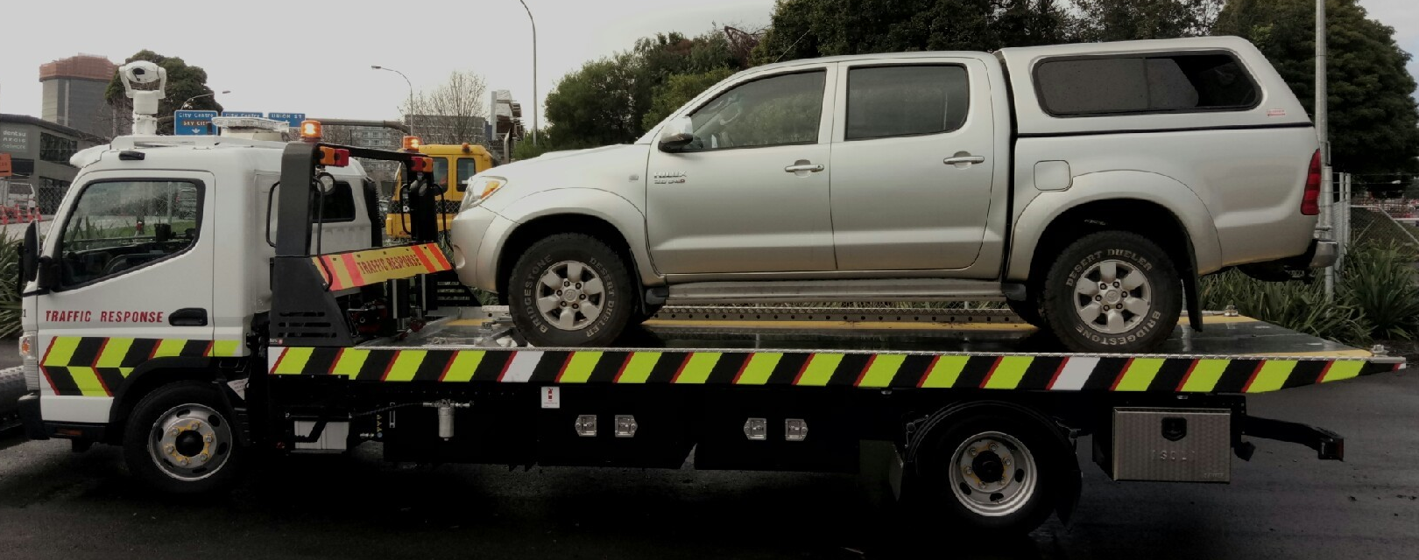
Do more: Tow Truck

Slide 44
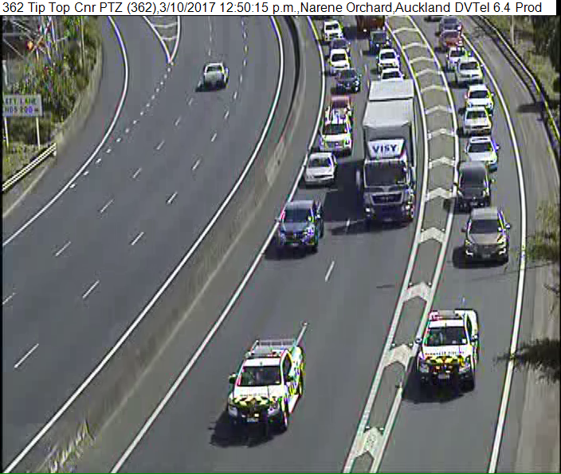
Do more: Traffic Response

Slide 45
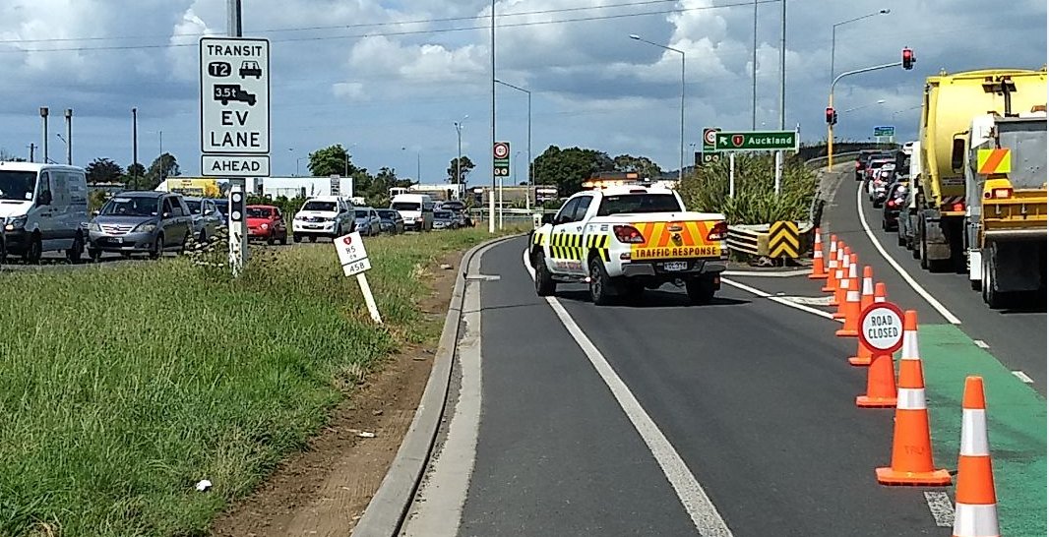
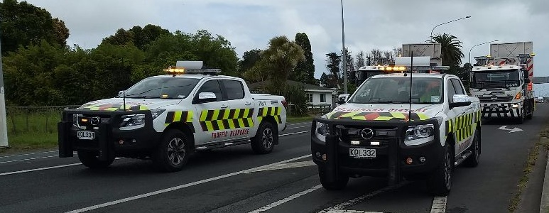
TRU Functions

Slide 46
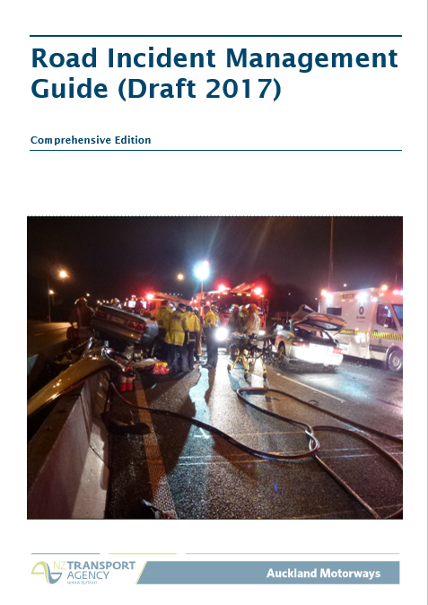
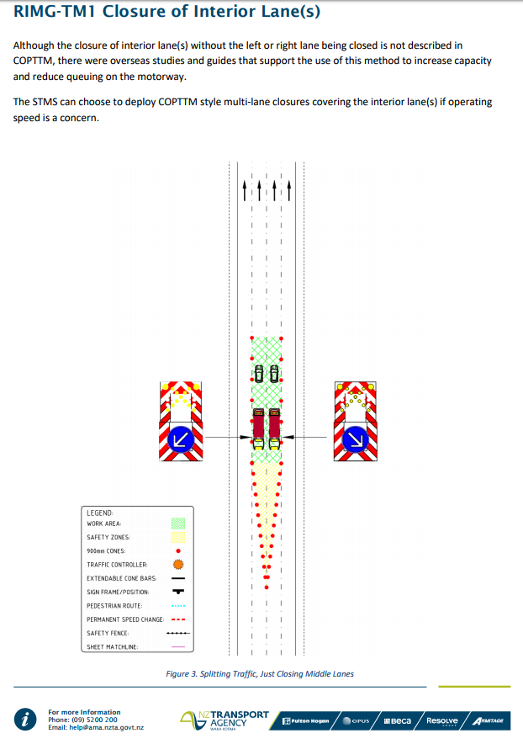
Knowledge Transfer

Slide 47
End
Questions.

